Slide 2
55th Annual Convention of Pakistan Society of Sugar Technologists, 2023, Karachi.

Slide 3
TOPIC Case study of Power Saving through the operation of Energy Efficient Welding Plant

Slide 4
By: Engr: Misri Khan Khoso General Manager (Electrical & Instrument) Faran sugar mills limited

Slide 5
ABSTRACT
During Off Season for Repair Maintenance of Sugar Mills Electricity is necessary. In existing scenario rate of fuel and Electricity are increasing day by day and in Off Season cost of sugar Mills Electricity is unavoidable factor of total maintenance cost. Main Consumer of Electricity during off season is welding section.

Slide 6
This paper is a case study regarding the existing practices and the operation of welding plants with related equipment and use of efficient equipment. Comparison of data reveals a significant saving of electricity due to the adoption of efficient equipment.

Slide 7
INTRODUCTION
It is necessary for Pakistan Sugar Industry to relook their Off Season repair maintenance budgets and eliminates dependability on usual method of tools and reduced the consumption of energy. Energy Sector in Pakistan is very saturated and standby option means diesel Generator beyond to use against repair maintenance of machinery.

Slide 8
During Off Season for repair maintenance of house welding Plant is very necessary and welding Plant is major consumer of Electricity and almost disturbing MDI and quality of Power.

Slide 9
We calculated load of welding plants at Faran sugar Mills against repair maintains and found that 40% load pertains to welding plants. We made few experiments with Inverter type Welding Plant and normal Transformer type Welding plant of same capacities and results illustrated in following Tables

Slide 10
Table - 1 (Electric Load Comparison)
Inverter Type Welding Plant of 400 A |  |  |  |  | Normal Transformer Type Welding Plant of 400 A
Sr.# | Setting of Amp | Size Of Welding Rod | Load in Ampere | Cycles (R-30/KWh) recoded at Energy Meter | Setting of Amp | Size Of Welding Rod | Load in Ampere | Cycles/KWh recoded at Energy Meter
1 | 150 | 10 mm | 6.8 | 2(1000/30)=66.66 W | 150 | 10 mm | 21.9 | 3(1000/30)=99.99 W
2 | 250 | 8 mm | 12 | 3(1000/30=99.99 W | 250 | 8 mm | 27 | 4.5(1000/30)=150 W
3 | 400 | 6 mm | 13.6 | 4(1000/30=133.32W | 400 | 6 mm | 36 | 7(1000/30=233.31W

Slide 11
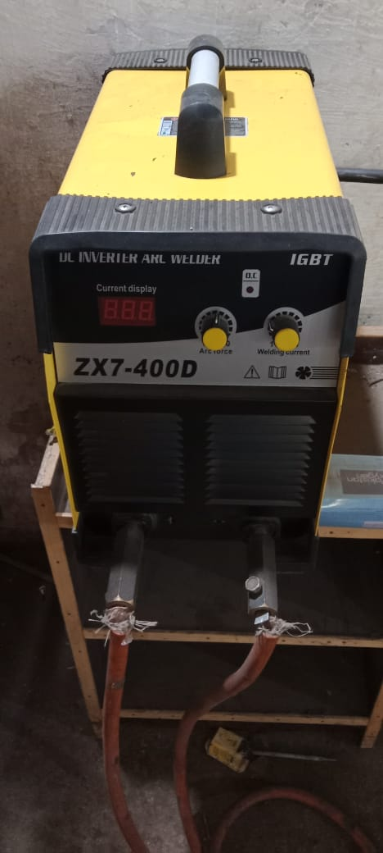
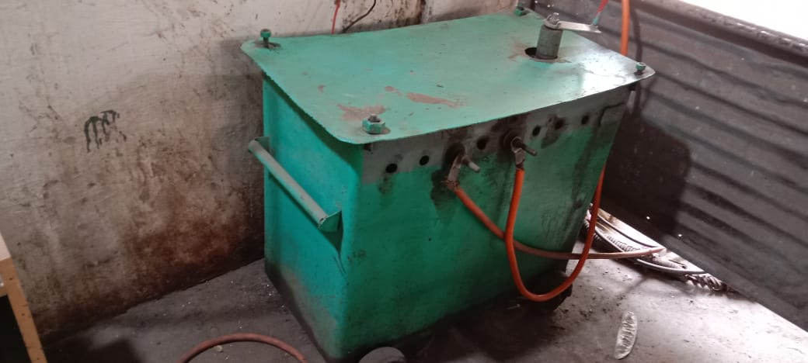
Inverter Type Welding Plant of 400 A
Normal Transformer Type Welding Plant of 400 A

Slide 12
In case of 10mm rod at the setting of 150 A Inverter Type welding plant consumed 15 Rods in 1 KWh or units and Normal Welding Plant at same setting consumed 10 Rods as show in Video #2
In case of 8mm rod at the setting of 250 A Inverter Type welding consumed 10 Rods in 1 KWh or units and Normal Welding Plant at same setting consumed 6.6 Rods as show in Video no # 1

Slide 13
In case of 8mm rod at the setting of 400 A Inverter Type welding consumed 7.5 Rods in 1 KWh or units and Normal Welding Plant at same setting consumed 4.28 Rods as show in video # 3
One major advantage observed at no load, Inverter Type welding Plant at Idle Load noted 0.4 A while Normal Welding plant consumed 3.8 A at No load.

Slide 14
Inverter Type Welding Plant of 400 A
Video # 02

Slide 15
Normal Transformer Type Welding Plant of 400 A
Video # 1

Slide 16
Table – 2
Inverter Type Welding Plant of 400 A |  |  |  |  | Normal Transformer Type Welding Plant of 400 A
Sr. # | Setting of Amp | Size Of Welding Rod | Calculation | Work done against 1 KWh | Setting of Amp | Size Of Welding Rod | Calculation | Work done against 1 KWh
1 | 150 | 10mm | W/consumption 1000/66.66 W | 15 Rods | 150 | 10mm | W/consumption 1000/99.99W | 10 Rods
2 | 250 | 8 mm | W/consumption 1000/99.99 W | 10 Rods | 250 | 8 mm | W/consumption 1000/150W | 6.66 Rod
3 | 400 | 6 | W/consumption 1000/133.32 W | 7.5 Rods | 400 | 6 mm | W/consumption 1000/233.31W | 4.28 Rods

Slide 17
Inverter Type Welding Plant of 400 A |  |  |  |  | Normal Transformer Type Welding Plant of 400 A
Sr. # | Setting of Amp | Size Of Welding Rod | Calculation | Work done against 1 KWh | Setting of Amp | Size Of Welding Rod | Calculation | Work done against 1 KWh
1 | 150 | 10mm | W/consumption 1000/66.66 W | 15 Rods | 150 | 10mm | W/consumption 1000/99.99W | 10 Rods
2 | 250 | 8 mm | W/consumption 1000/99.99 W | 10 Rods | 250 | 8 mm | W/consumption 1000/150W | 6.66 Rod
3 | 400 | 6mm | W/consumption 1000/133.32 W | 7.5 Rods | 400 | 6 mm | W/consumption 1000/233.31W | 4.28 Rods

Slide 18
Each Sugar Mills using welding rods during off season for their repair maintenance and for capex projects in tons. We calculated consumption of electricity at Normal Transformer Type Welding plants against all welding rods used in Off Season 2022-23 at Faran Sugar Mills Detail is mentioned in Table - 3.

Slide 19
Table - 3 (Normal Transformer Type Welding plants)
Sr. # | Type of Welding rod | Weight in Kgs | Pock of welding rods | NO of Welding Rods | Total Welding Rods | Total Units /KWh Consumed | Cost of one Unit of Electricity | Total Amount in Rupees
1 | 12 No | 40 | 16 | 154 | 2,464 | 246.4 | 44 | 10,841
2 | 10 No | 6,640 | 1,660 | 138 | 229,080 | 22,908.00 | 44 | 1,007,952
3 | 8 No | 1,340 | 335 | 91 | 112,225 | 16,850.60 | 44 | 741,426
4 | 6 No | 300 | 60 | 59 | 3,540 | 827 | 44 | 36,388
 | Total Amount |  |  |  |  |  |  | 1,796,607

Slide 20
Table - 4 ( Inverter Type Welding Plant of 400 A)
Sr. # | Type of Welding rod | Weight in Kgs | Pock of welding rods | Total Welding Rods | Total Welding Rods | Total Units /KWh Consumed | Cost of one Unit of Electricity | Cost of one Unit of Electricity
1 | 12 No | 40 | 16 | 16 | 2,464 | 164 | 44 | 7,216
2 | 10 No | 6,640 | 1,660 | 1,660 | 229,080 | 15,270 | 44 | 671,880
3 | 8 No | 1,340 | 335 | 335 | 112,225 | 11110 | 44 | 488,840
4 | 6 No | 300 | 60 | 60 | 3,540 | 470 | 44 | 20,680
 | Total Amount |  |  |  |  |  |  | 1,188,616

Slide 21
One Major advantage observed at no load, Inverter Type welding Plant at Idle Load noted 0.4 A while Normal Welding plant consumed 3.8 A at No load

Slide 22
Table - 5
Sr. No | Description | Invert type welding plant data | transformer type welding plant data | Remarks
01 | At No Load | (0.4 x400x0.9x1.73)/1000 = 0.249 Kw | 3.8x400x0.9x1.73/1000 = 2.36 KW
02 | Difference | 0.249 Kw - 2.36 KW 2.11 KW

Slide 23
It is observed that one welder can’t continue welding full time mostly speed efficient welder is used welding rod 60% means 40% time welding Plant remain Idle so it is calculated as follows .
If one welder average working is 7 Hrs at one welding plant then welding plant Idle losses are 2.11x40x7 /100= 5.908 Kwh

Slide 24
If one Mill engaged 8 welder or welding plant then total losses are 5.908 x8 = 47.26 KWh
If Welding remained 5 Month in Season and Off Season than one year Losses are 47.26 x150 = 7089 KWh means 7089 x44 = Rs. 311,916/=

Slide 25
Total Saving against Normal welding plant = (Sheet 3 -Sheet 4) + Difference of No Load = (1,796,607 -1,188,616) + 311,916= Rs.919, 907/=
As we mentioned above total 8 Welding plants are in use one welding plant given saving of 919,907/8 = Rs.114, 988 /= per year.

Slide 26
PAYBACK
Price of Inverter Type Welding Plant of 400 A = Rs.85, 000/=
Price of transformer Type Welding Plant 400 A = Rs.160, 000/=

Slide 27
No Payback against Transformer Type Welding Plant
4. If only Inverter Type welding required to Purchase then it’s payback is 114,988/150= Rs.766/= means 85000/766=111 say 4 months

Slide 28
Advantages of Inverter Type welding Plant
It consumed minimum power
It is consuming 10 times minimum power that standard welding plant in Idle Conditions
It is low price
It is lighter in weight may be used everywhere without extending leads and Power Leads
It is required low rating switch gears

Slide 29
CONCLUSION
Inverter Type Welding Plants are much energy efficient than conventional type welding plants. The payback period (4 months) falls this investment into a very low hanging fruit category.

Slide 31
Thanks

